Slide 1
Spring AspectJ
Instruction: NGUYEN ANH MINH (M. Sc.)

Slide 2
Outline
Implementing aspect
AspectJ APIs and annotations
AOP Proxies
Spring AOP

Slide 3
Aspect

Slide 4
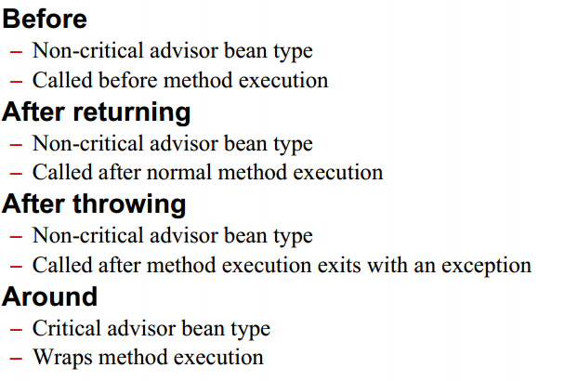
Advice

Slide 5
Before advice

Slide 6
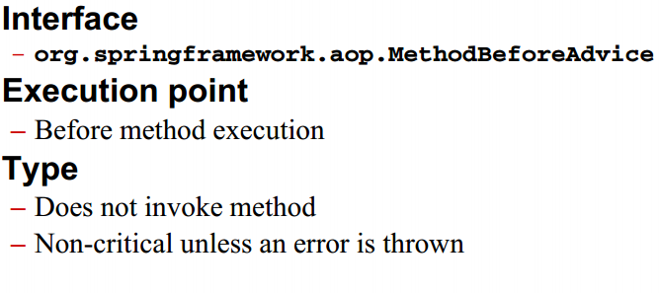
Before advice

Slide 7
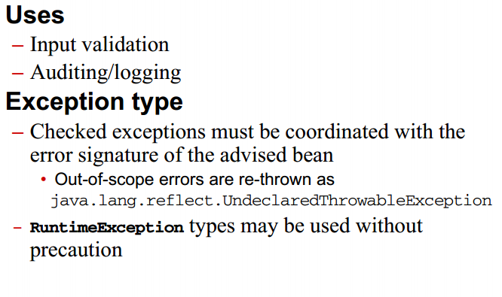
Before advice guideline

Slide 8
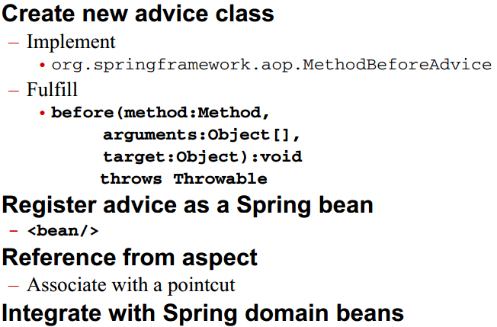
Before advice process

Slide 9
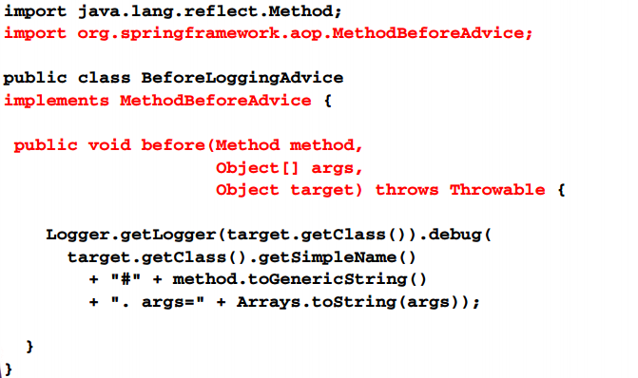
Create before advice class

Slide 10
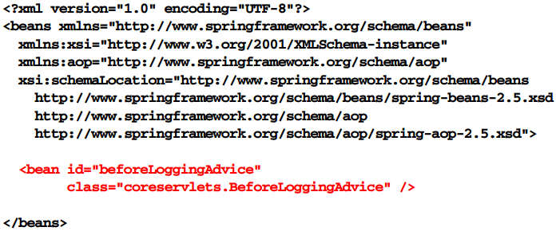
Register before advice bean

Slide 11
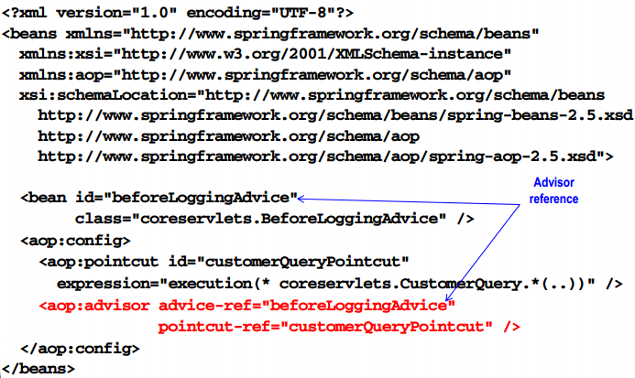
Reference from aspect

Slide 12
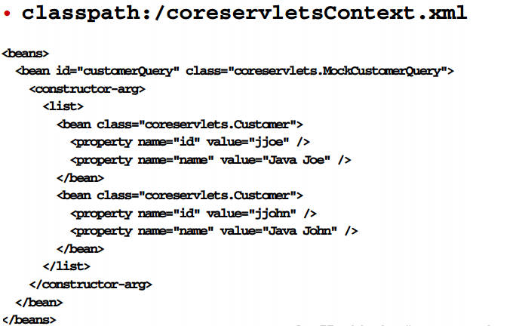
Domain beans

Slide 13
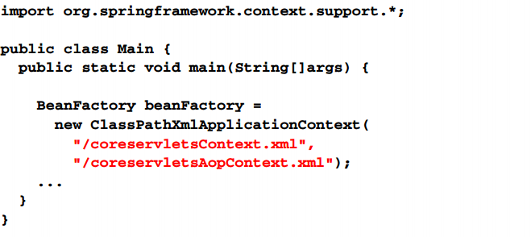
Integrate advice with domain beans

Slide 14
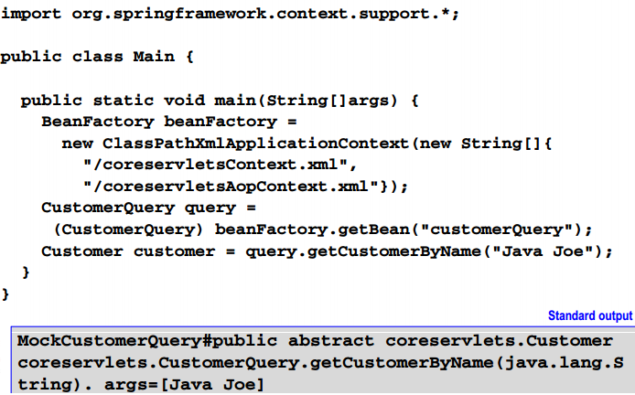
Access and use beans

Slide 15
After returning advice

Slide 16
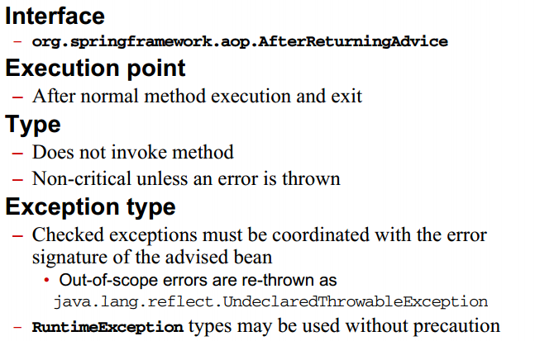
After returning advice

Slide 17
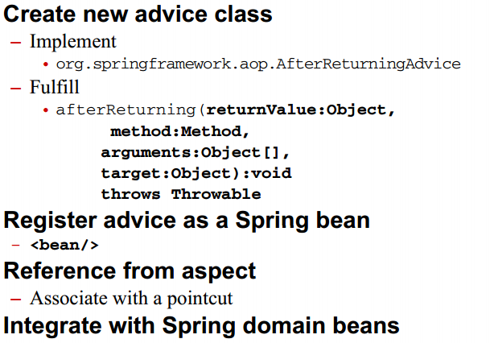
After returning advice

Slide 18
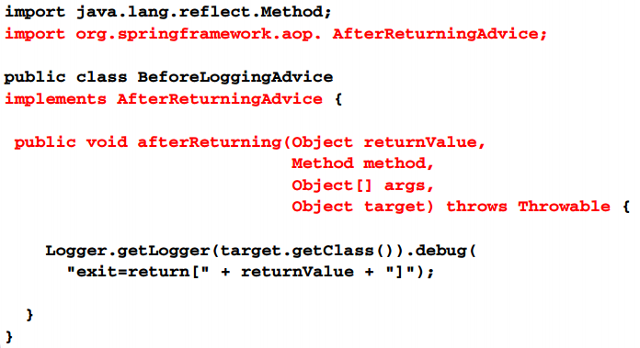
After returning advice class

Slide 19
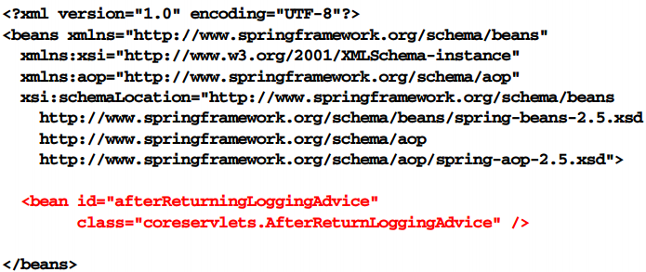
Register after returning advice bean

Slide 20
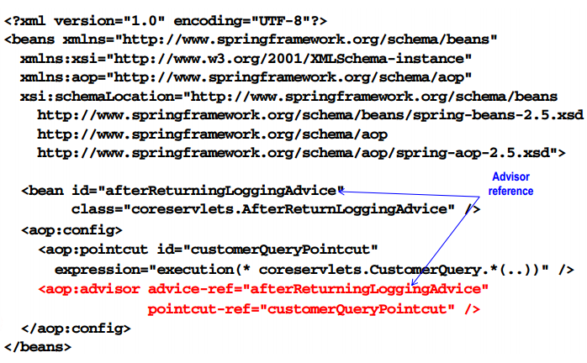
Reference from aspect

Slide 21
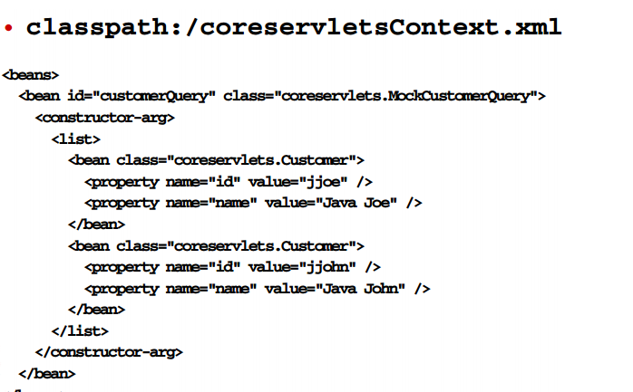
Domain beans

Slide 22
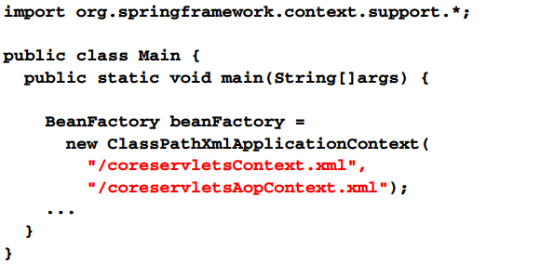
Integrate advice with domain bean

Slide 23
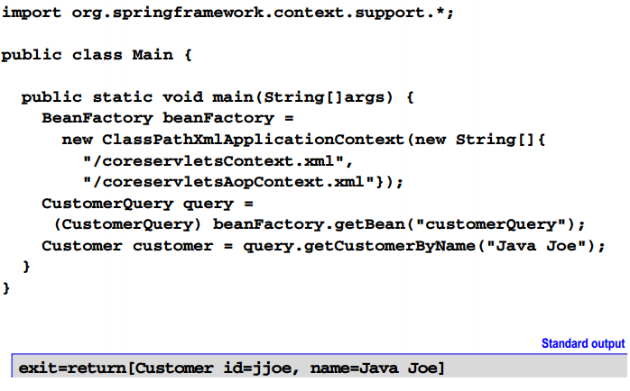
Access and use beans

Slide 24
AspectJ pointcuts

Slide 25
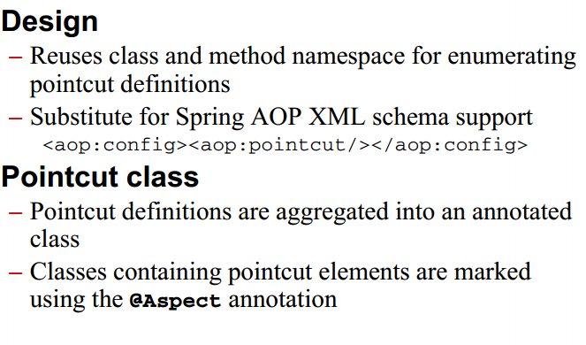
AspectJ pointcuts introduction

Slide 26
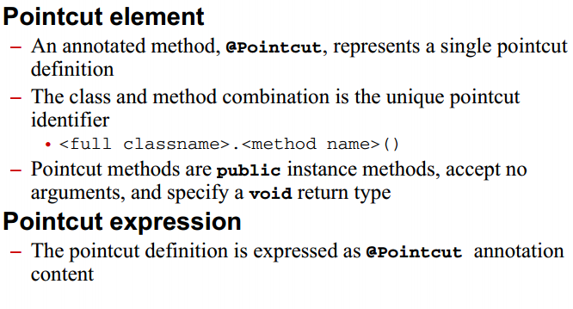
AspectJ pointcuts introduction

Slide 27
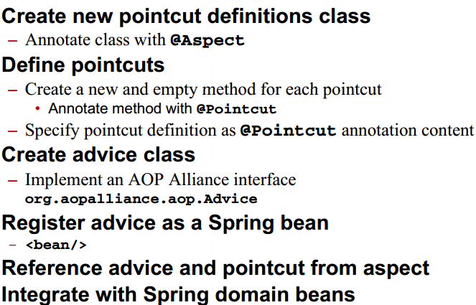
AspectJ pointcuts process

Slide 28
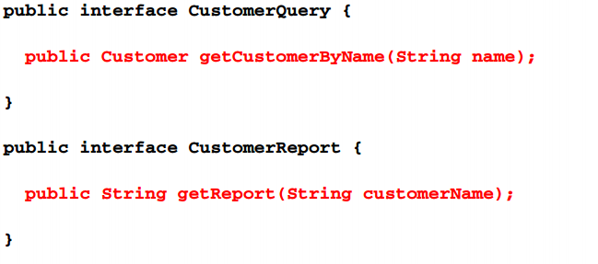
Select join point

Slide 29
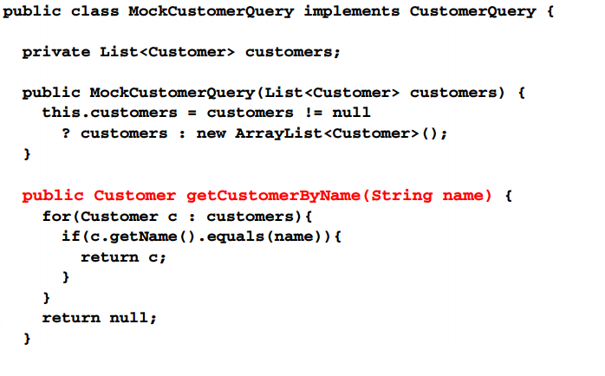
Select join point

Slide 30
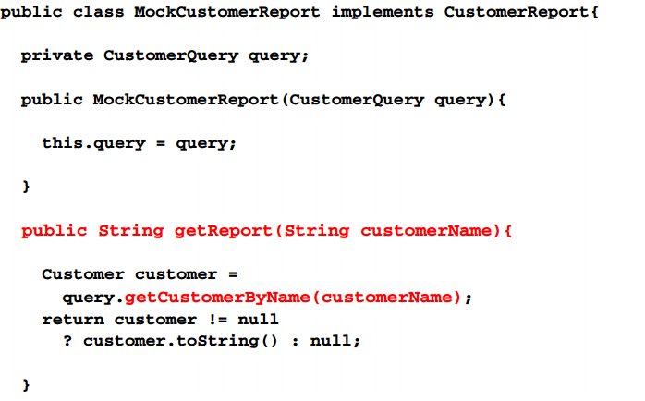
Select join point

Slide 31
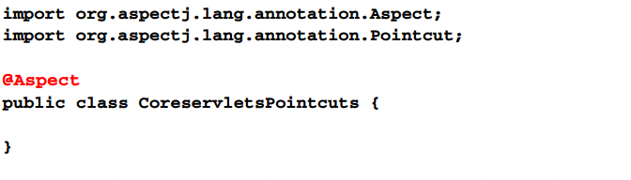
Create pointcuts definition class

Slide 32
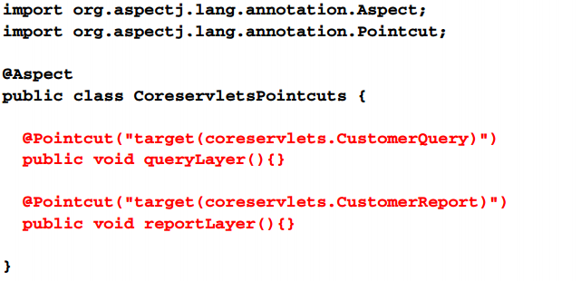
Define pointcuts

Slide 33
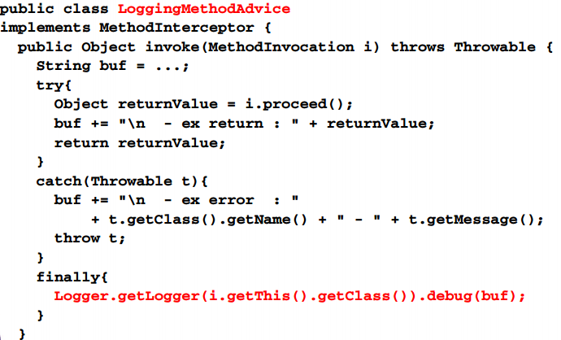
Create advice class

Slide 34
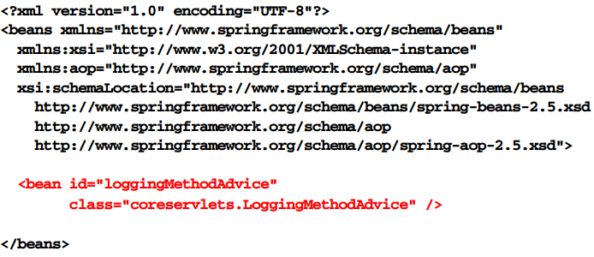
Register advice bean

Slide 35
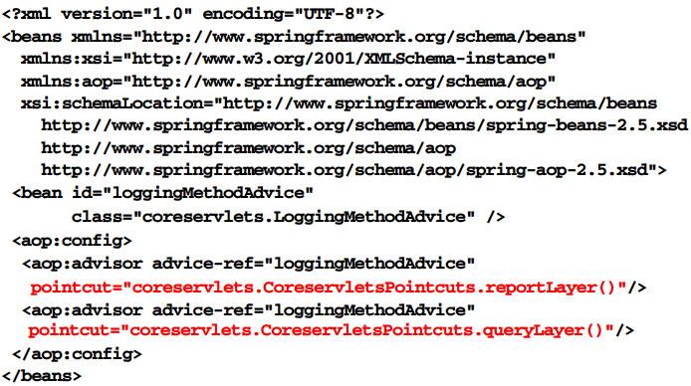
Define aspect

Slide 36
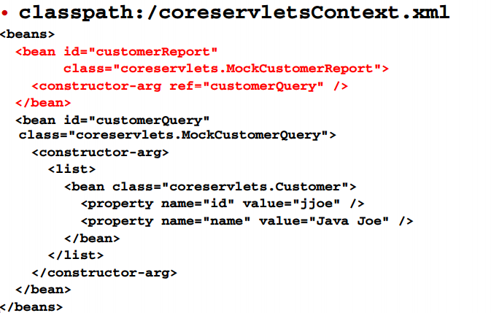
Domain beans

Slide 37
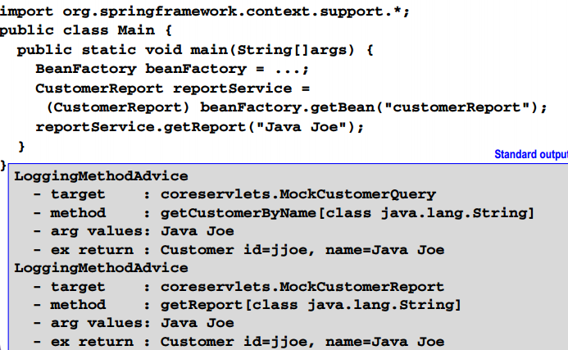
Access and use beans

Slide 38
AspectJ advice

Slide 39
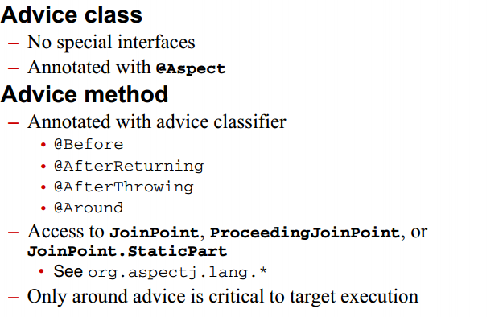
AspectJ advice introduction

Slide 40
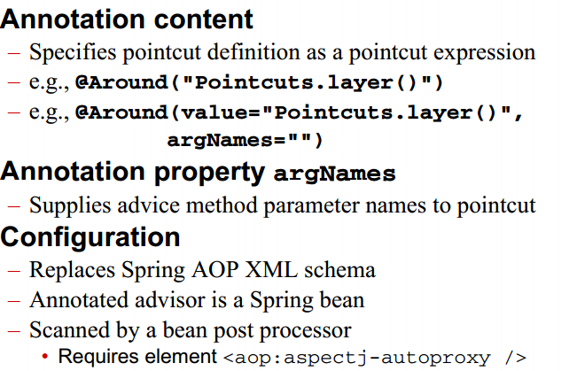
AspectJ advice

Slide 41
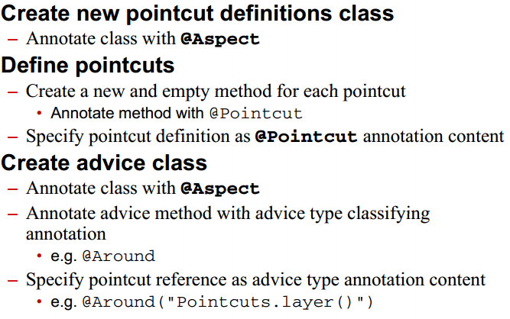
AspectJ pointcut process

Slide 42
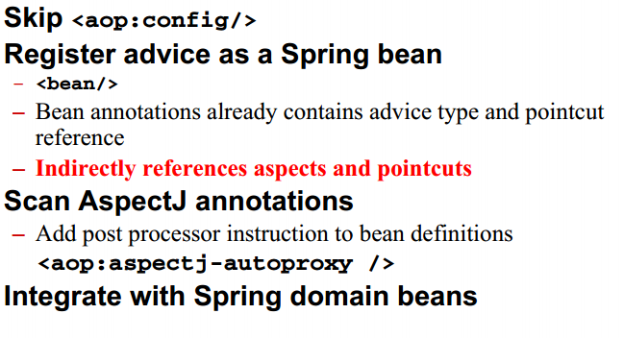
AspectJ pointcut process

Slide 43
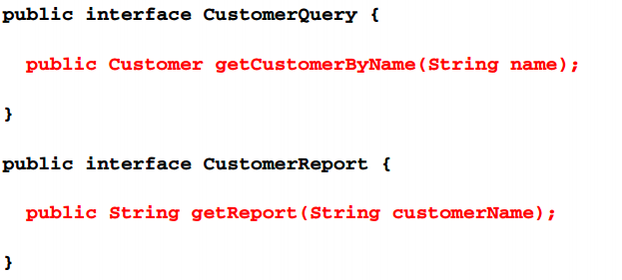
Select join points

Slide 44

Select join points

Slide 45
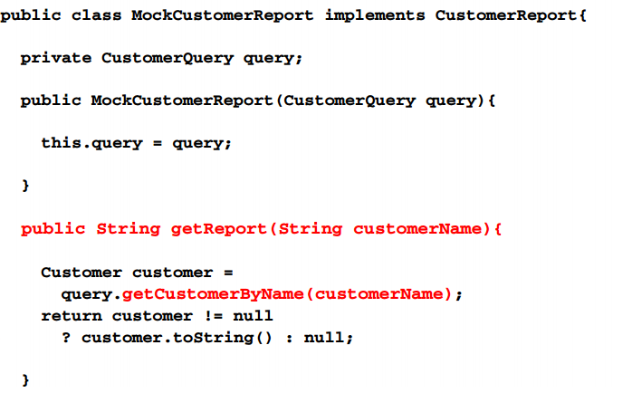
Select join points

Slide 46
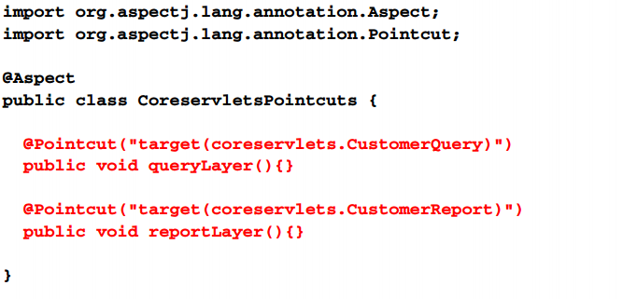
Define pointcuts

Slide 47
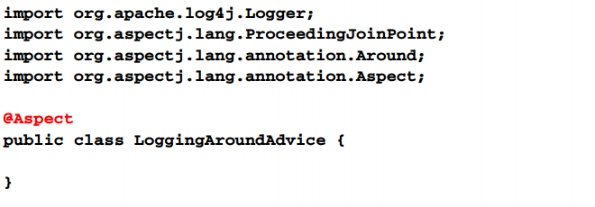
Create advice class

Slide 48
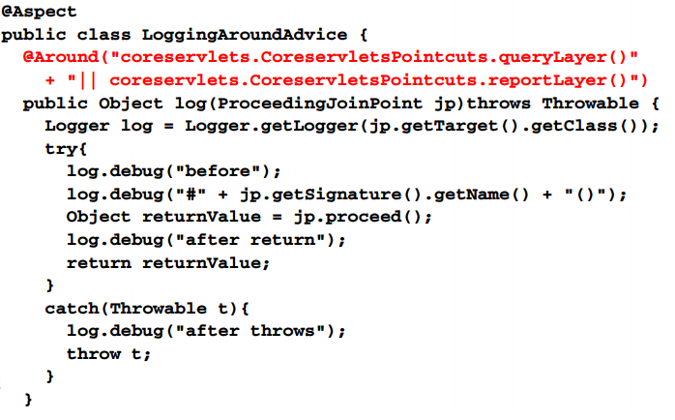
Create advice class

Slide 49
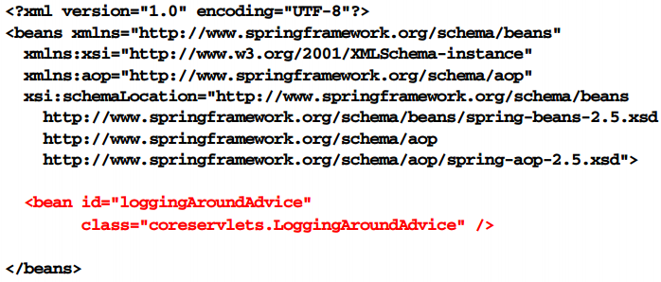
Register advice bean

Slide 50
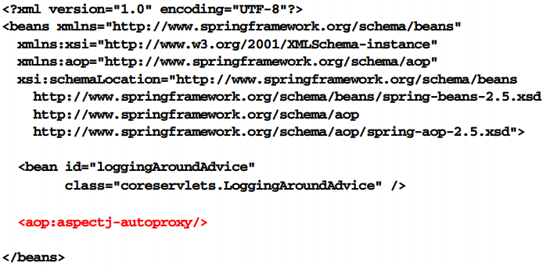
Register bean postprocessor

Slide 51
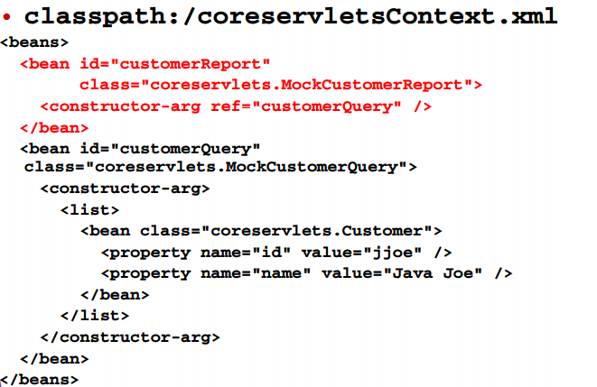
Domain beans

Slide 52
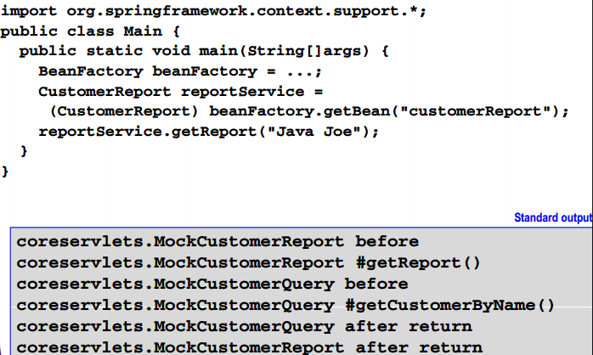
Access and use beans

Slide 53
AspectJ advice with spring AOP xml

Slide 54
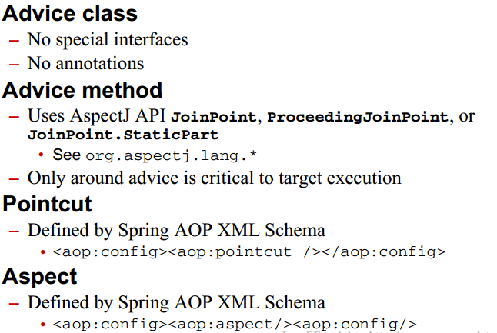
AspectJ advice with spring aop xml

Slide 55
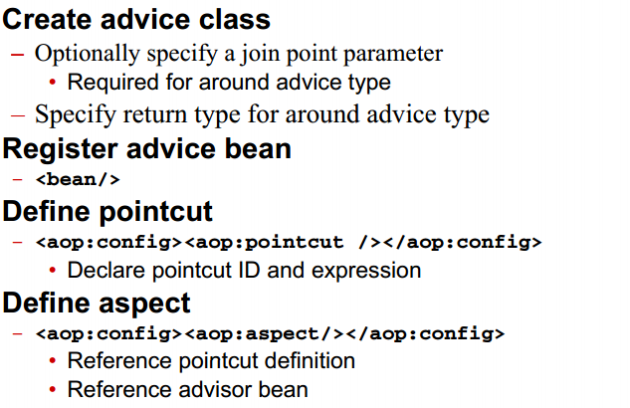
Process

Slide 56
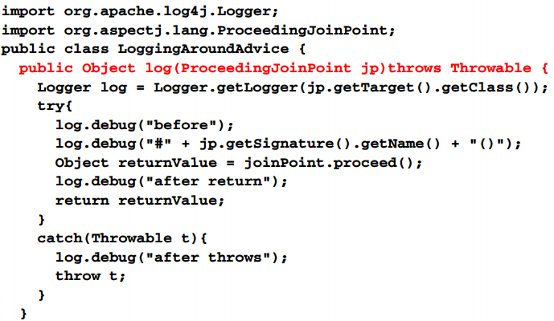
Create advice class

Slide 57
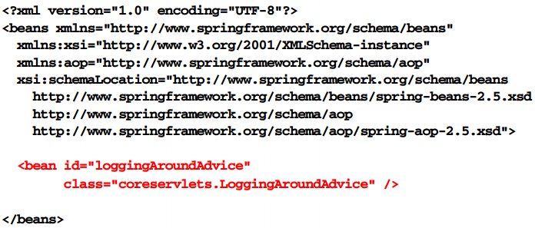
Register advice bean

Slide 58
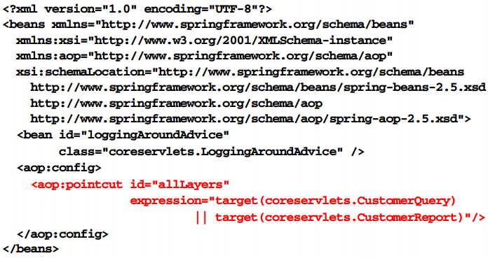
Define pointcut

Slide 59
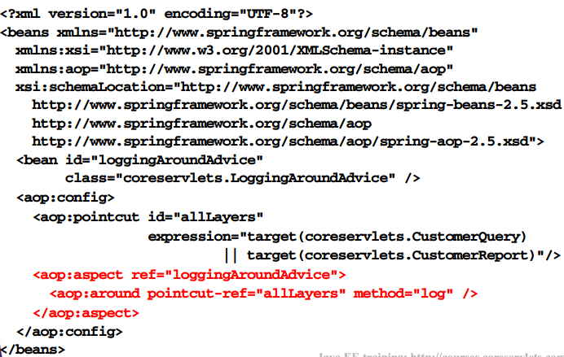
Define pointcut

Slide 60

Domain beans

Slide 61

Access and use Beans

Slide 62
AOP PROXIES

Slide 63


AOP PROXIES

Slide 64

AOP PROXIES

Slide 65
Spring AOP application

Slide 66

JDBC transaction management using AOP

Slide 67

JDBC transaction management using AOP

Slide 68

Process

Slide 69

Process

Slide 70

Process

Slide 71

Develop persistence library

Slide 72

Develop persistence library

Slide 73

Develop persistence library

Slide 74

Select join points

Slide 75

Create bean definitions

Slide 76

Create spring AOP/tx definitions

Slide 77

Register transaction manager

Slide 78

Register advice bean

Slide 79

Define pointcut

Slide 80

Define aspect

Slide 81

Initializer container

Slide 82

Test transaction manager

Slide 83

Summary

Slide 84

Summary

